Slide 1

Basic Details of the Team and Problem Statement
Ministry/Organization Name/Student Innovation:
Ministry of Education
PS Code: 1434
Problem Statement Title: Making career choices and AI based counselling accessible to every child at secondary level along with aptitude tests and detailed career paths.
Team Name: TechTitans
Team Leader Name: Atharva Joshi
Institute Code (AISHE): C-34671 Institute Name: Deogiri Institute of Engineering and Management Studies
Theme Name: Smart Education

Slide 2
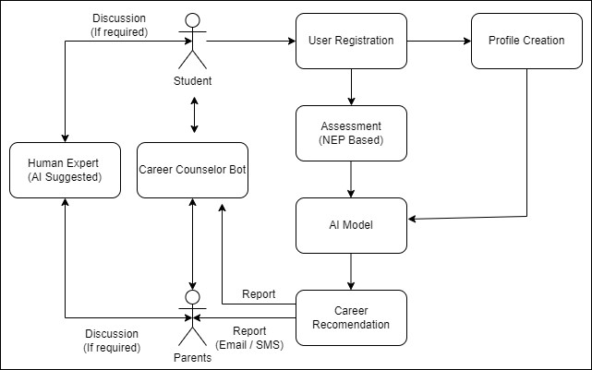
Idea/Approach Details
We aim to provide career guidance to students using interactive aptitude, psychometric tests. Our AI-based platform will not only provide generic suggestions based on user’s interest, but also follow National Education Policy(NEP) to provide holistic guidance that’ll benefit the world while filling the pockets & souls of the student. Here's an overview of our solution:
Idea/Solution/Prototype here:
User Registration: Students will create accounts with basic information like age, educational background, and interests.
Aptitude Assessment: Students will take aptitude tests designed to evaluate their strengths, weaknesses, and interests. These tests will cover various domains such as mathematics, science, arts, and more.
Interest Mapping: The system will use AI algorithms to map the aptitude and personality assessment results to potential career paths and suggest a list of suitable professions.
Career Exploration: Students can explore the suggested careers with detailed information, including job descriptions, required skills, educational paths, and salary ranges.
One-on-One Counseling: For more personalized guidance, Students can schedule personalized virtual counseling sessions with career experts, teachers, mentors, and access 24/7 support from our Career Expert Bot.
Technology stack:
Frontend : HTML, CSS, JavaScript, Tailwind CSS, ReactJS
Backend :
- Python, NodeJs, ExpressJS, Java
- Database – MongoDB
- AI/ML – Machine learning(Scikit-Learn, Gensim) Deep Learning(TensorFlow, Keras) NLP(NLTK, SpaCy)

Slide 3
Idea/Approach Details
Show stoppers
Our platform assesses emotional intelligence, a key career skill, and integrates students' hobbies and interests into personalized career planning for a holistic approach to align passion with potential paths.
Our platform offers both national and international career options while also suggesting relevant scholarships based on selected career paths.
We'll connect students with experienced professionals to offer personalized career guidance through AI-Powered Mentor Matching.
Students can connect with peers who share similar career interests, fostering a supportive and motivating community.
Our platform will be accessible to individuals with disabilities, including those with visual or hearing impairments, through features such as screen readers and closed captions.
Multi-language support will make our platform accessible to a wider audience by accommodating various regional languages in India.
We will streamline and reduce the duration of aptitude tests to ensure a more efficient and user-friendly experience while maintaining accuracy in assessing students' strengths and abilities for career planning.
Use Cases
Student Self-Assessment: Secondary-level students can use the platform to assess their aptitudes and personalities, providing them with career suggestions.
Parental Engagement: Parents can access their child's profile and career recommendations, facilitating informed discussions about their child's future.
Educational Institutions: Schools can integrate this platform into their career counseling programs, helping students make informed choices.
Career Counselors: Professional career counselors can use the platform to streamline their counseling sessions and access data-driven insights.
Government and Education Authorities: Government bodies can use platform data for informed education policy decisions and resource allocation.

Slide 4
Team Member Details
Team Leader Name: Atharva Kiran Joshi
Branch : Btech Stream : CSE(AIML) Year: IV
Team Member 1 Name: Preshit Mangesh Desai
Branch : Btech Stream : CSE (AIML) Year: IV
Team Member 2 Name: Pradip Sanjay Dound
Branch : Btech Stream :CSE (AIML) Year: IV
Team Member 3 Name: Nilesh Ashok Thengde
Branch : Btech Stream : CSE (AIML) Year: IV
Team Member 4 Name: Mayuri Shamsundar Sarda
Branch : Btech Stream : CSE (AIML) Year: IV
Team Mentor 1 Name: Prachi Anil Joshi
Category : Academic Expertise : DSA/Cloud Computing Domain Experience (in years): 10+

